Slide 1




Next Gen Employability Program
Full Stack Web Development with AI Tools
Team Details – NG_CP_Team_452
Name: Ansh Sharma
Name: Ayushi Singh
Name: Tanu Pant
College: Inderprastha Engineering College, Ghaziabad

Slide 2

The content is curated from online/offline resources and used for educational purpose only.
Notes:
Speaker would be briefing the students that this content has been prepared for the educational purpose only and is referred from multiple sites which are cited in the last.​​
---------------------------------------------------​​
A disclaimer is a statement or notice that is intended to clarify, limit, or provide information about the scope, limitations, or potential risks associated with certain actions, information, products, services, or content. ​​
​​
​

Slide 3

Project Title
AI POWERED SEARCH ENGINE OPTIMIZATION SYSTEM
Notes:
In this slide speaker will be introducing the program and its outcomes. The speaker will introduce himself in brief

Slide 4

Table of Contents
Introduction
Problem Statement
Proposed Solution
Key Features
Technology Stack
System Flowchart
Core Modules
Conclusion and Future work
References
Notes:
This slide, The speaker will talk about the content that we will be covering in this session as follows:
Introduction
Importance of UI/UX in industry
History and Definitions of UI and UX
Key Differences between UI/UX
Use Cases
Significance in Web Development
Use Cases
Visual Design Principles
Design process
Color theory and psychology
Typography and readability
Layout and Spacing
Responsive design basics
Usability and Accessibility
Usability Aspects
Web Content Accessibility Guidelines (WCAG)
Inclusive design practices
Consistency
User Experience
User-Centered Design
User research methods
Interactive Elements and Feedback
Mini Case Study
Discussing a popular UI/UX design
Hands-On
Introduction to Figma for UI/UX design

Slide 5
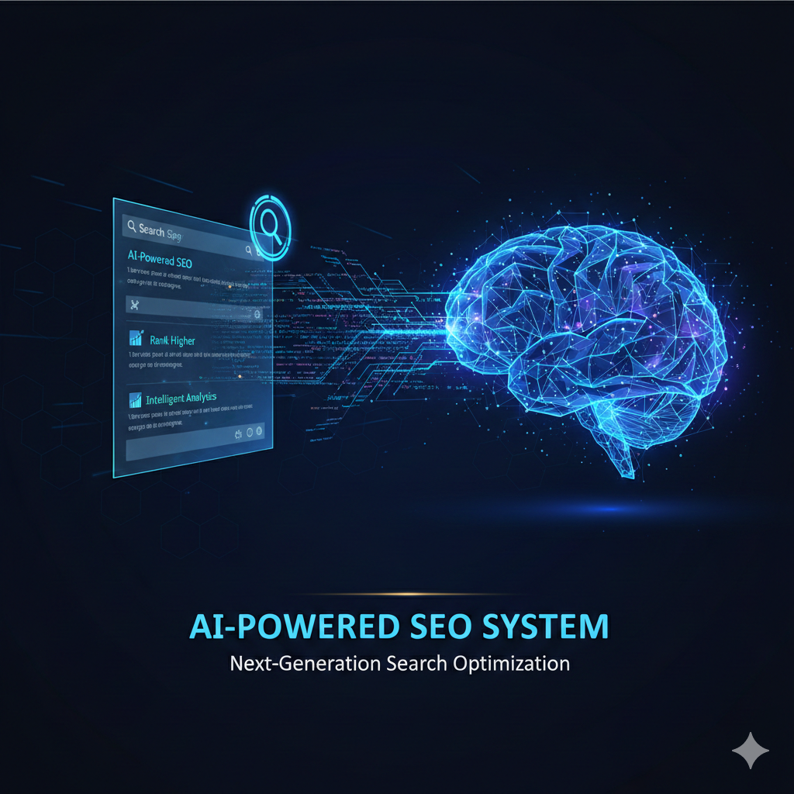
Introduction
AI SEO is a web-based application that analyzes website content and provides SEO scores with optimized suggestions using artificially intelligent rule-based analysis.
SEO improves a website’s ranking on search engines.
Analyzes website content quality.
Provides data-driven SEO insights and Improvements.
Increasing website visibility across the web
Notes:
This slide, The speaker will talk about the content that we will be covering in this session as follows:
Introduction
Importance of UI/UX in industry
History and Definitions of UI and UX
Key Differences between UI/UX
Use Cases
Significance in Web Development
Use Cases
Visual Design Principles
Design process
Color theory and psychology
Typography and readability
Layout and Spacing
Responsive design basics
Usability and Accessibility
Usability Aspects
Web Content Accessibility Guidelines (WCAG)
Inclusive design practices
Consistency
User Experience
User-Centered Design
User research methods
Interactive Elements and Feedback
Mini Case Study
Discussing a popular UI/UX design
Hands-On
Introduction to Figma for UI/UX design

Slide 6
Problem Statements
Traditional SEO is time-consuming.
Beginners struggle to optimize content.
High dependency on expensive SEO expertise.
Expensive SEO tools in market.
Businesses struggle to adapt to frequent search engine algorithm changes.
Startups are drowning in SEO metrics (rankings, backlinks, DA) but lack a tool that tells them exactly what to change today for revenue.
Notes:
This slide, The speaker will talk about the content that we will be covering in this session as follows:
Introduction
Importance of UI/UX in industry
History and Definitions of UI and UX
Key Differences between UI/UX
Use Cases
Significance in Web Development
Use Cases
Visual Design Principles
Design process
Color theory and psychology
Typography and readability
Layout and Spacing
Responsive design basics
Usability and Accessibility
Usability Aspects
Web Content Accessibility Guidelines (WCAG)
Inclusive design practices
Consistency
User Experience
User-Centered Design
User research methods
Interactive Elements and Feedback
Mini Case Study
Discussing a popular UI/UX design
Hands-On
Introduction to Figma for UI/UX design

Slide 7
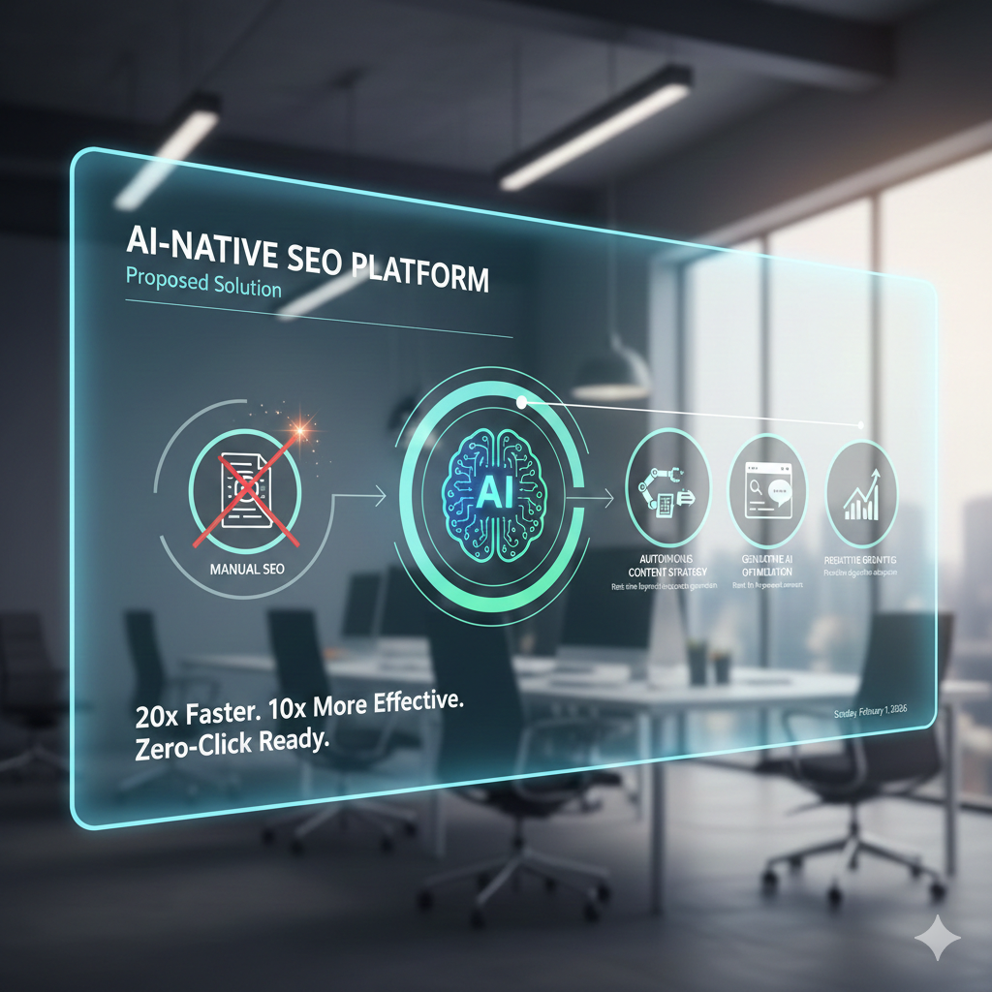
Proposed Solution
Scalable AI-powered SEO optimization system
Manages keyword research and content analysis
Applies actionable SEO recommendations
Renders real-time performance insights
Technical knowledge not required

Slide 8
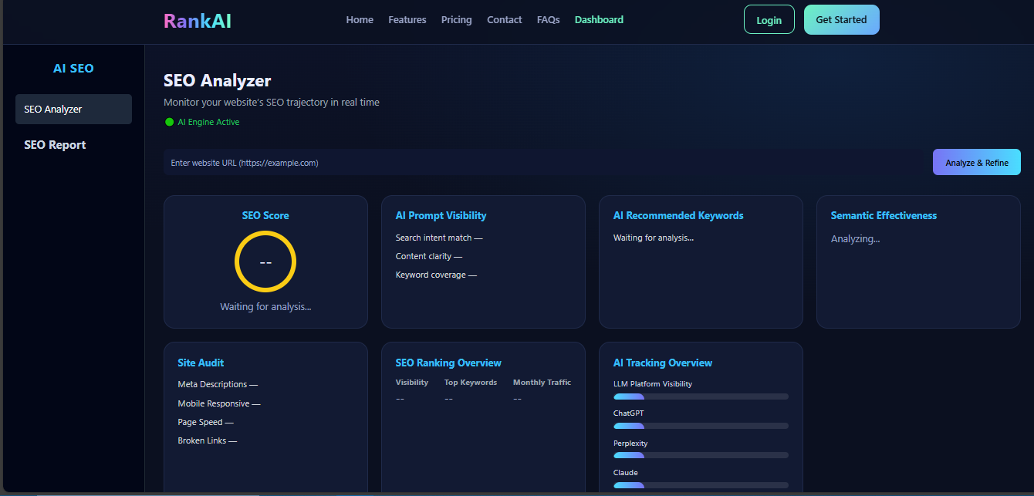
Key Features
SEO score (0–100) generation
Keyword density analysis
Clean and user-friendly dashboard
Meta title & description validation
Content improvement suggestions
AI SEO focuses on semantic authority and entity mapping.
Manual SEO takes weeks; AI SEO adapts in real-time to algorithm shifts.
Notes:
This slide, The speaker will talk about the content that we will be covering in this session as follows:
Introduction
Importance of UI/UX in industry
History and Definitions of UI and UX
Key Differences between UI/UX
Use Cases
Significance in Web Development
Use Cases
Visual Design Principles
Design process
Color theory and psychology
Typography and readability
Layout and Spacing
Responsive design basics
Usability and Accessibility
Usability Aspects
Web Content Accessibility Guidelines (WCAG)
Inclusive design practices
Consistency
User Experience
User-Centered Design
User research methods
Interactive Elements and Feedback
Mini Case Study
Discussing a popular UI/UX design
Hands-On
Introduction to Figma for UI/UX design

Slide 9
Technical Stack
Frontend: HTML, CSS, JavaScript
Backend: Python and Django framework
API Layer: Django API for seamless communication between frontend and AI services.
Web Scraping: request , Beautifulsoup(bs4)
AI & Machine Learning: ML models and algorithms sklearn.linear_model, TfidfVectorizer,NLP and LLms for predictive SEO and content generation.
Database: SQLite3 for lightweight, efficient, and reliable data storage.

Slide 10
Core Modules:
SEO Analyzer Module: Analyzes website URL to evaluate overall SEO performance in real time.
Keyword Analysis Module: Identifies relevant keywords, search intent, and keyword coverage using AI.
Content & Semantic Analysis Module:Evaluates content clarity, relevance, and semantic effectiveness.
SEO Scoring & Ranking Module: Generates SEO score and tracks keyword ranking performance.
AI Recommendation Module: Provides actionable suggestions to optimize content and SEO strategy.

Slide 11
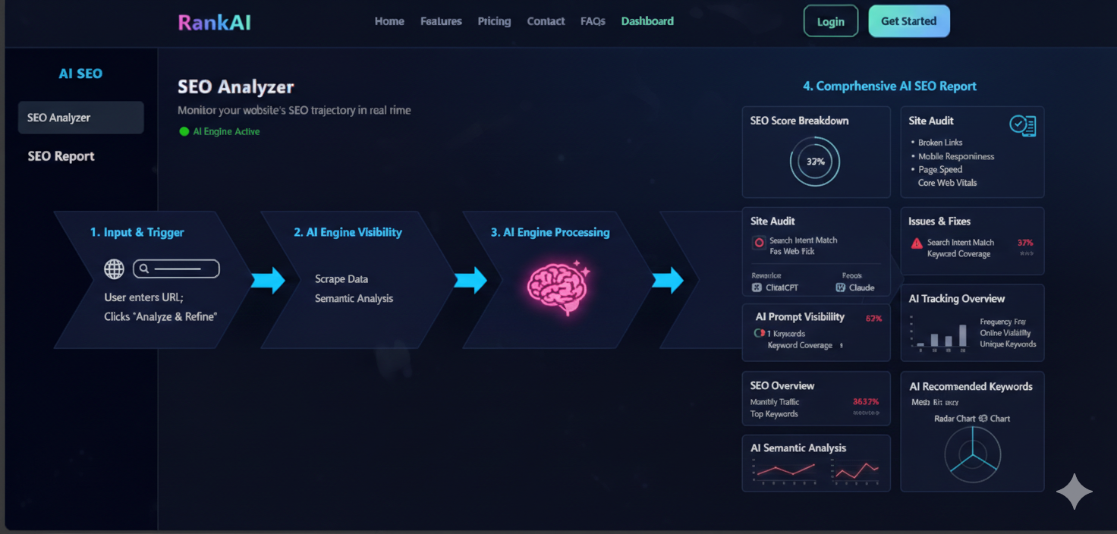
System Flowchart

Slide 12
Conclusion and Future work
Progressing SEO evaluation beyond single-dimension analysis
Refining scoring using adaptive intelligence models
Integrating off-page and technical SEO factors
Strategic benchmarking for informed optimization
Maturing the system for scalable deployment
Expanding optimization to include AI-driven analysis for voice search, video transcripts, and visual search rankings
Integrate Multi-Language Localization

Slide 13
References
Brin & Page : Established foundational web search ranking principles.
Google SEO Guide : Standard benchmarks for technical site compliance.
Jain & Kumar : Transitioned manual SEO to AI-driven automation.
BERT (Devlin et al.) : Revolutionized intent-based semantic search understanding.
Google Core Vitals : Critical metrics for user experience performance.
TF-IDF – Term Weighting Revisited : Rank keywords by importance.
Notes:
This slide, The speaker will talk about the content that we will be covering in this session as follows:
Introduction
Importance of UI/UX in industry
History and Definitions of UI and UX
Key Differences between UI/UX
Use Cases
Significance in Web Development
Use Cases
Visual Design Principles
Design process
Color theory and psychology
Typography and readability
Layout and Spacing
Responsive design basics
Usability and Accessibility
Usability Aspects
Web Content Accessibility Guidelines (WCAG)
Inclusive design practices
Consistency
User Experience
User-Centered Design
User research methods
Interactive Elements and Feedback
Mini Case Study
Discussing a popular UI/UX design
Hands-On
Introduction to Figma for UI/UX design

